Slide 1
JavaScript L&D Sessions

Slide 2
Introduction

Slide 3
About the Sessions
Learn JavaScript from scratch
According to popularity, will continue with more advanced topics
Help you to quickly get started on building web apps leveraging latest and greatest frameworks
Finally, You will be capable of materializing your ideas on web platform

Slide 4






Our Team
Experts Panel -:
Newbie -:

Slide 5
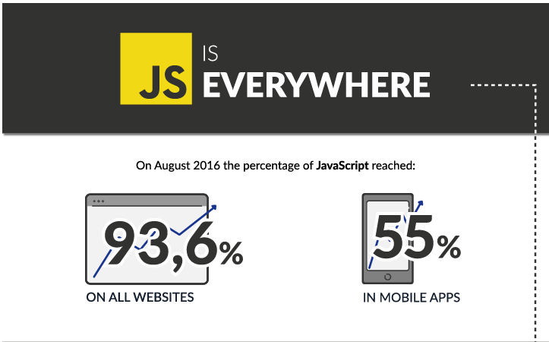
Why JavaScript?

Slide 6
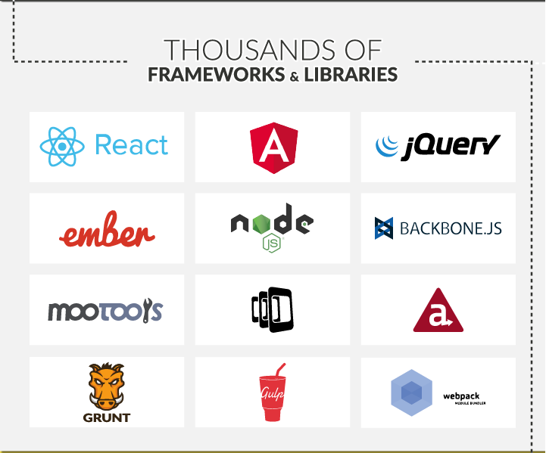

Slide 7
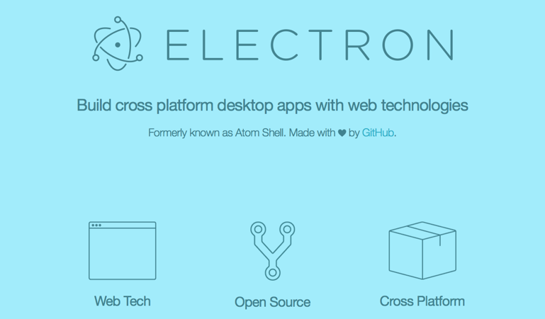


Slide 8
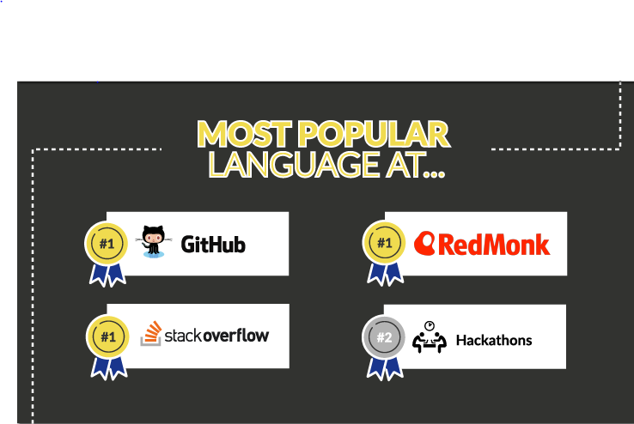

Slide 9
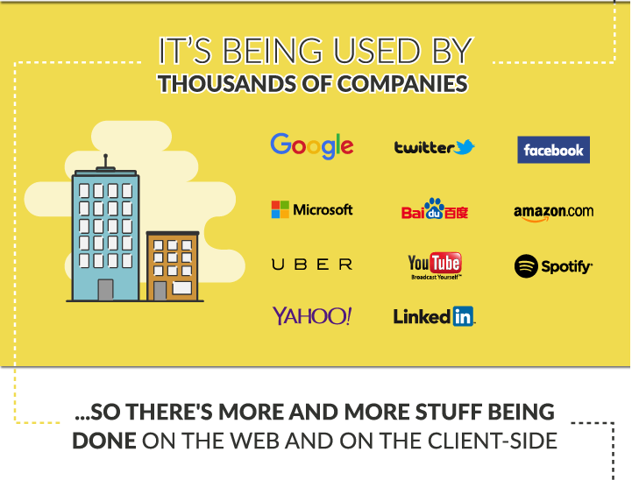

Slide 10
JavaScript : Citadel
Citadel is rapidly working to migrate desktop Apps written in WPF to Web based apps using frameworks such as React/Angular.
Last Year, Citadel management released details on how it will adapt Openfin as a standard for building apps.
More work around server side as they start building REST Apis for Gs on Nodejs.
Javascript know-how will ease this process for you.

Slide 11
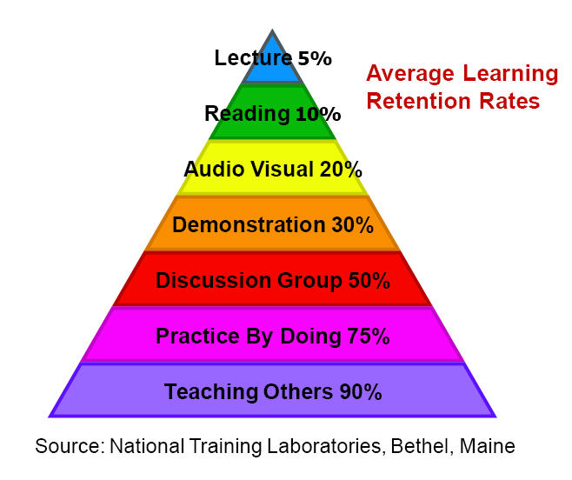
What’s my benefit?

Slide 12
How will we approach LEARNING?
Introduce to a real world abstract concept/ quote
Link it with the world of programming
Approach the topic w.r.t JavaScript
Why?
Help you relate the topic
Retention will be better

Slide 13
Looking at the past makes us realize how far we have come in future

Slide 14
Introduction to JavaScript
JavaScript : Past, Present, Future
What is JavaScript currently?
Where does it fit in?

Slide 15
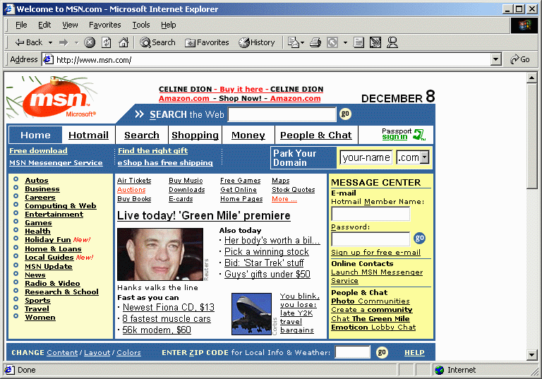
JavaScript: Past , Present , Future
Javascript was built by Brenden Eich
Earlier, It was used to have some simple behavior change(validation etc.) on the client side.

Slide 16

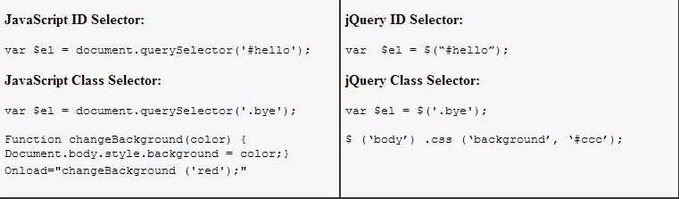
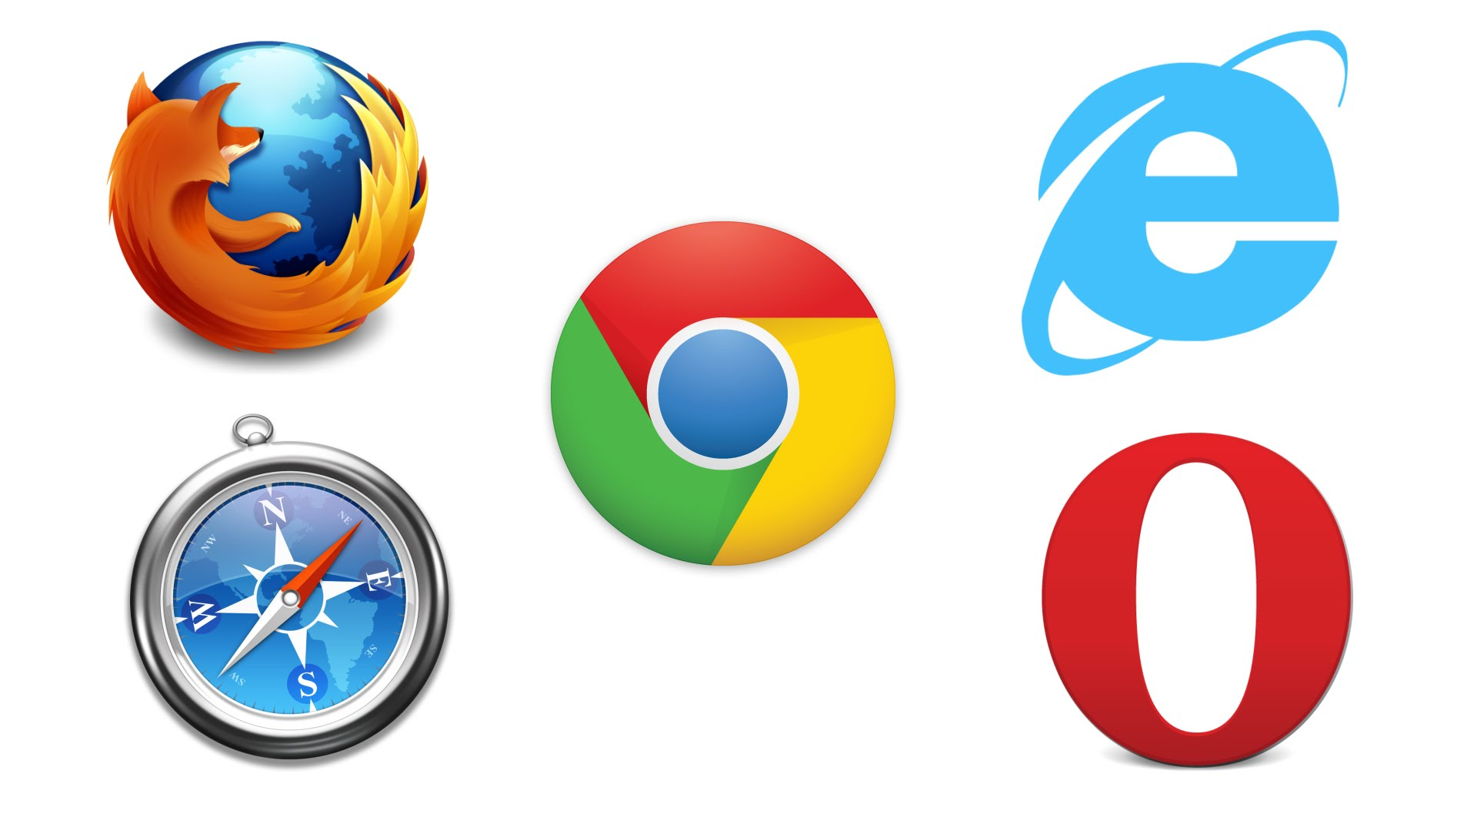

Slide 17

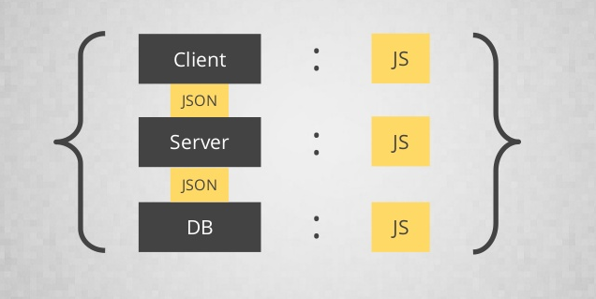
Google’s JavaScript Engine : V8
V8 Engine is a highly optimized Javascript engine, that is used in Chrome Browser
It is also used on server side in Nodejs and MongoDB due to its performance
Due to this JavaScript became a vital component in FULL-STACK Development

Slide 18
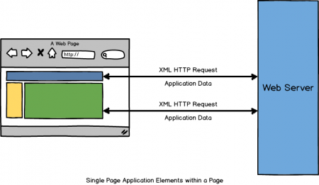



Rise of Single Page Applications
As client side became more powerful, It gave rise to Single page applications on web, which mimic standard desktop application
The REST based architectures began to rise, where server was used to get data through Ajax , without refreshing the actual page.
Client Side Frameworks ->

Slide 19

What is JavaScript Currently?
JavaScript is a premier client/server-side dynamic language used on web today, It’s widely used in full stack development which includes tasks ranging from
validation of form data to the creation of complex user interface on the client.
Writing non blocking code on server side
managing NoSql database on backend.
GOTO Link :- http://matthew.wagerfield.com/parallax/

Slide 20


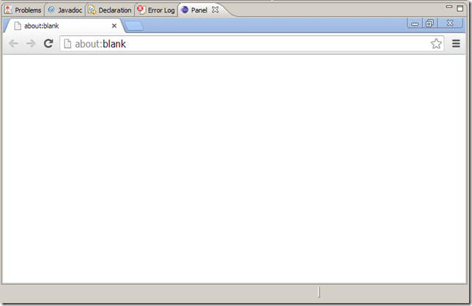
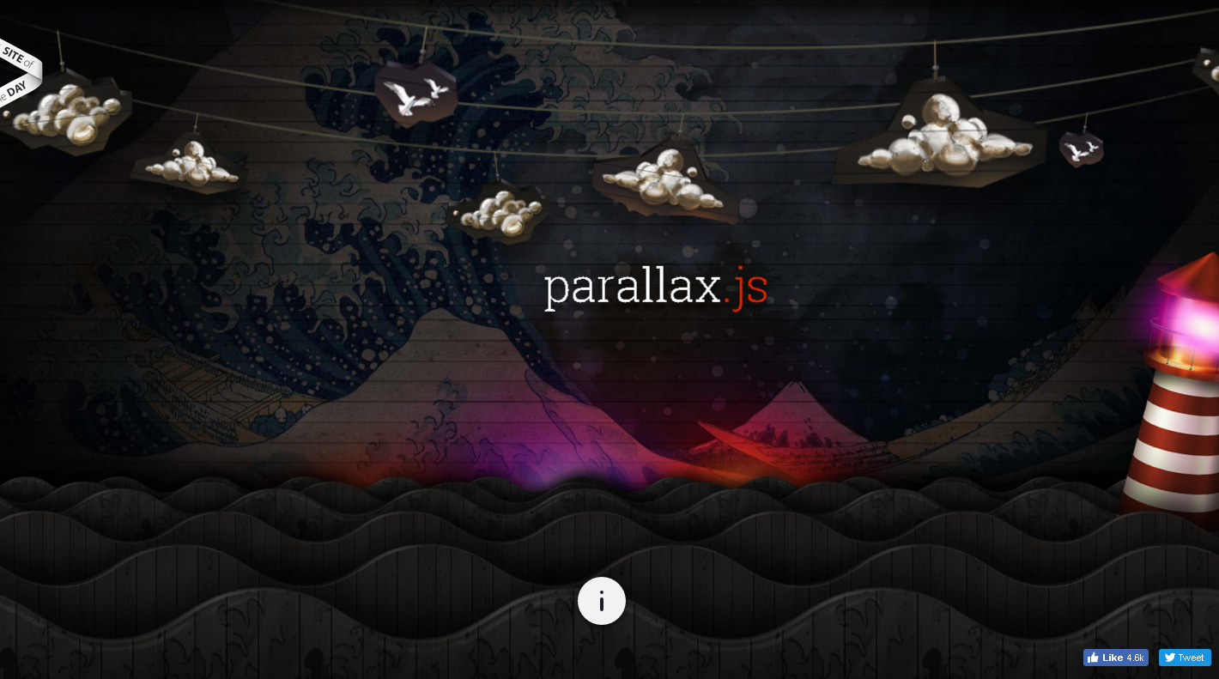
Where does it fit in?
http://matthew.wagerfield.com/parallax/
HTML+CSS+JS+Resources
Browser Engine Renders Everything

Slide 21

HTML Document Object Model
When the webpage is loaded , browser creates DOM of the page
The HTML DOM model is constructed as a tree of Objects
With object model, Javascript gets all the power it needs to create dynamic HTML

Slide 22
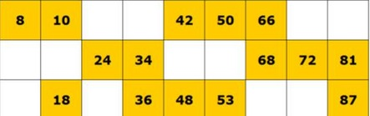
It’s like playing tambola
Css styles
Traverse DOM
HTML
Manipulation of HTML through JavaScript

Slide 23
Playground:
a place with a specific design to allow children to play there

Slide 24



Playgrounds in JavaScript

Slide 25

Hands On

Slide 26
Let’s Summarize
JavaScript is a full fledged client/server language used on web platform with capabilities of building complex user interface, Writing non-blocking code on server side and managing NoSql databases,
HTML + JavaScript + CSS = Client Side Web Platform

Slide 27
Browser Engine renders the client side code.
Browser creates a Document Object Model i.e. a tree structure of the html so that JavaScript is able to traverse through and manipulate html.
We can embed Javascript by adding <script> tag , html events etc.
Rapidly prototype apps using latest and greatest frameworks

Slide 28
Thank You

